Slide 1




Slide 2

Unit 5: Applications of AI and Machine learning
Lecture 6
School of Computer Science UPES, Dehradun
India

Slide 3
Table of Contents
Artificial Intelligence in Energy & Utilities
Defect detection and predictive maintenance
Transforming the customer experience
Forecasting the water and energy consumption

Slide 4
Learning & Course Outcomes
LO1: Understand the role of AI in Energy and Utilities.
LO2: Examine real world case studies to forecast the water and energy consumption.
LO3: Identify the challenges faced in applying AI in Energy and Utilities.
CO4: Assess and model real-world practical problems that can be handled by AI and ML.

Slide 5
Artificial Intelligence in Energy & Utilities
92% of companies are investing in AI or plan to do so within two years.
67% of energy executives see AI benefits in better customer experiences.
Over 50% benefit from improved decision-making and product innovation.

Slide 6
Defect detection and predictive maintenance
One of the challenges that the energy & utilities companies face is detecting suspect pipes/wiring/machines or defects in fault-susceptible processes. Breakages are costly for utilities – in both financial capital and brand value. Defect detection becomes a priority for the field to avoid noticeable losses.
35% of energy executives are realizing AI’s benefits in performing predictive maintenance and automating routine tasks (33%). AI image recognition and computer vision systems allow to cost-effectively process photos and videos of the facilities to alarm employees if any breakage is concerned.

Slide 7
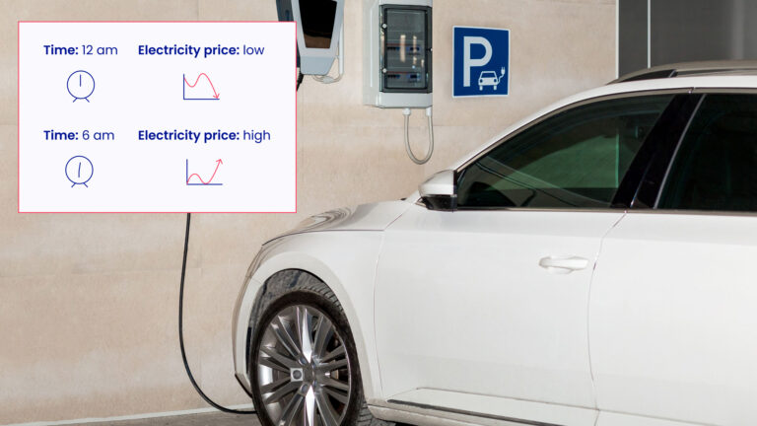
Transforming the customer experience
The utility suppliers can predict with the help of AI the consumption of water/heating/energy and thus come up with dynamic pricing to offer super low variants when there is excess capacity.

Slide 8
Transforming the customer experience
AI provides a highly personalized view of those household interactions with different appliances through sophisticated disaggregation and customer segmentation.
Thus, the customer, concerned with the bill size, could adjust and regulate their utility consumption in the most rational way.

Slide 9
Transforming the customer experience
For instance, artificial intelligence informs a utility that household ‘A’ has an electric vehicle using a charger between midnight and 6 a.m. each night.
Now, utility suppliers have the option to suggest those householders charge their EV earlier when electricity is cheaper.

Slide 10
Forecasting the water and energy consumption
Effective distribution of utility production can be a key to the sustainable growth of supplying companies. The energy consumption makes up 25-30% of total operation and maintenance (O&M) costs. AI can optimize runtimes of equipment so that they are only used when they are needed.

Slide 11
Forecasting the water and energy consumption
In the graph, you can see the example of a three-zone power system based on data from Great Britain. Supply and consumption have to match in real-time, excess power should be transmitted to the regions with higher demand, and energy transfers between regions are limited by network capacity.
Artificial intelligence is invited to create cost-effective strategies for scheduling the power consumption, with the potential savings of the consumer money, and accelerate decarbonization.

Slide 12
AI-Powered increasing the efficiency of Energy Storage
According to EPRI, current new-energy storage systems “are typically 4-hour duration or less, corresponding to peaking capacity and ancillary services needs.
However, in the coming years as storage is deployed to replace higher capacity factor conventional generation, absorb longer periods of renewable overgeneration, and support resilience during severe weather events there is a potential need for longer duration storage.”

Slide 13
AI-Powered increasing the efficiency of Energy Storage
Material research, prototyping, testing, validation, and lifecycle assessment that used to take a lot of time in the labs can now be done in a virtual laboratory. Thus, it can speed up the research and development of new materials.
Because of the rapid storage and release of energy from renewable sources, the requirements of high charge and discharge rates and low cost are becoming increasingly important. Thus, AI and ML are used to predict new battery material discovery and establish a new understanding of material behavior.

Slide 14
References
NTEL Lectures: https://archive.nptel.ac.in/courses/106/102/106102220/
Roy, D. (2024). AI for Utilities: Reimagining the Future Energy System. United States: Apress.
Intelligent Renewable Energy Systems: Integrating Artificial Intelligence Techniques and Optimization Algorithms. (2022). United Kingdom: Wiley.

Slide 15
MCQs
1. What is the primary goal of using AI in energy management systems?
To increase the complexity of energy systems
To reduce the efficiency of energy usage
To optimize energy consumption and enhance efficiency
To make energy systems completely manual
2. Which of the following AI techniques is commonly used for predicting energy consumption?
Genetic Algorithms
Convolutional Neural Networks
Linear Regression
K-Nearest Neighbors

Slide 16
MCQs
3. How can AI contribute to the management of renewable energy sources?
By increasing dependency on fossil fuels
By improving prediction of renewable energy production
By reducing the integration of renewable sources into the grid
By minimizing the use of smart grids
4. Which of the following is NOT a benefit of using AI in utilities?
Enhanced predictive maintenance
Improved customer service
Increased operational costs
Efficient grid management

Slide 17
MCQs
5. In smart grids, what role does AI play?
It helps in manual meter readings.
It is used to forecast energy demands and optimize grid operations.
It increases the grid's carbon footprint.
It reduces the use of smart meters.
6. What is a major challenge in implementing AI in energy and utilities?
Lack of data
Overabundance of skilled personnel
Integration with existing systems
High energy efficiency

Slide 18
MCQs Answer
1. C
2. C
3. B
4. C
5. B
6. C

Slide 19

Thank You

